Slide 1
Oracle 11g SQL Certification Class ch 1-6
Steve Montgomery, certified sql expert

Slide 2
Oracle 11g SQL Certification Class Session 1
Course overview, setup

Slide 3
Session 1 objectives
Install Oracle 11g database from thumb drive
Introductions
Download and install SQL Developer
Run scripts
Expectations for class

Slide 4
Course Directories Setup
Create folder c:\oracleclass
Copy contents of thumb drive:\oracleclass to c:\oracleclass
Unzip (extract) OracleXE112_WinZip32.zip into c:\oracleclass\OracleXE112_WinZip32\
Unzip (extract) sqldeveloper-3.2.10.09.57.zip into c:\oracleclass\sqldeveloper\
Create folder c:\oraclexe

Slide 5
Oracle 11g Database Setup
Find c:\oracleclass\OracleXE112_WinZip32\Disk1\Setup.exe
Right-Click on Setup.exe
Choose Run as Administrator
Confirm it is installing into C:\oraclexe
Defaults: TNS port 1521, MTS Port 2030, HTTP Port 8081
IMPORTANT: WHEN PROMPTED FOR A PASSWORD ENTER> admin
Reboot
Find icon on desktop: Get Started with Oracle 11g Express Edition > Click to launch
Browser will start and display Oracle XE 11.2
Close Browser

Slide 6
SQL Developer Setup
Find c:\oracleclass\sqldeveloper\sqldeveloper.exe
Right click on the sqldeveloper.exe file. Select send to desktop (create shortcut)
Launch SQL Developer
Right click on Connections, select New Connection
In dialog Connection Name is ‘system’,
Username is ‘system’
Password is ‘admin’
Click Test, if success, click Connect
Notes:
From Start Page,
Launch tutorials on Start Page
Select Testing and Debugging Procedures using SQL Developer 3.1

Slide 7
SQL User Setup
In the system window that opens up, type the following:
create user books identified by books;
grant all privileges to books;
create user cruises identified by cruises;
grant all privileges to cruises;
Notes:
From Start Page,
Launch tutorials on Start Page
Select Testing and Debugging Procedures using SQL Developer 3.1

Slide 8
Course Connection Setup
Right click on Connections, select New Connection
In dialog Connection Name is ‘books’,
Username is ‘books’
Password is ‘books’
Click the save password checkbox
Click Test, if success, click Connect
Right click on Connections, select New Connection
In dialog Connection Name is ‘books’,
Username is ‘books’
Password is ‘books’
Click the save password checkbox
Click Test, if success, click Connect

Slide 9
Course Schema Setup
In SQL Developer, select File Open, browse to F:\oracleclasss\setup\
Select BookStore.sql and click Open
Select the books connection and click the Run Script button
Close BookStore.sql
In SQL Developer, select File Open, browse to F:\oracleclasss\setup\
Select Create_EFCodd_Version_X_Script_0.sql1 and Create_EFCodd_Version_X_Script_02.sql and click Open
Select the cruises connection for each file of these two files and click the Run Script button
Close the two sql files

Slide 10
Expectations
Roughly one chapter per session
Read before class
Practice Quizzes
Homework
Progress Reports

Slide 11
Oracle 11g SQL Certification Class Session 2 – Chapter 1
Introduction to SQL

Slide 12
Session 2 objectives
Definitions:
RDBMS, Table, Column, Field, Record, Row, SQL*Plus
Basics of RDBMS
Working with SQL Developer
Entity Relationship Diagrams
Basics of SQL
Normalization

Slide 13
Relational Data Base Management System
Schema – Databases have work areas base on a user account
Connection – We establish a connection to a database through the schema
Schema’s own objects, the most important of which is a table
Fields are attributes that define an entity and are represented by columns in a table
Records are entities described by those attributes and are rows in the table
Notes:
What's an RDBMS ?
This concept was first described around 1970 by Dr. Edgar F. Codd in an IBM research publication called "System R4 Relational".
A relational database uses the concept of linked two-dimensional tables which comprise of rows and columns. A user can draw relationships between multiple tables and present the output as a table again. A user of a relational database need not understand the representation of data in order to retrieve it.

Slide 14
Working with SQL Developer
Connections
Tables and other objects
Worksheet (Tools -> SQL Worksheet)
Script output
Query Results (result set)
Preferences -> Code Editor -> PL/SQL Syntax Colors

Slide 15
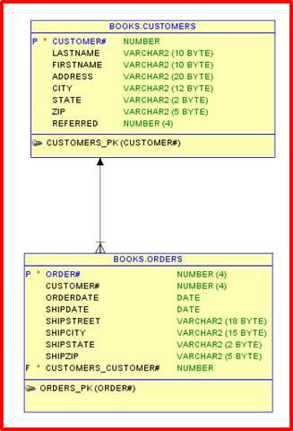
Entity Relationship Diagrams
Entity:
A thing which is independent and can be uniquely identified.
Something in the real world which can be distinguished from other things.
Book
Customer
Order

Slide 16
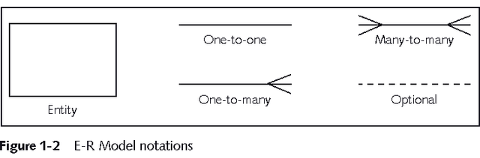
Entity Relationship Diagram
Relationship:
Captures how entities are related to one another.
Relationships are like verbs, linking two or more nouns.
One Customer has many orders.
Customer is the parent of the order.

Slide 17
Types of Relationships
One to one
A book can have only one publisher
A ship can have only one home port
One to many
An order can have multiple line items
A ship can have many staterooms
Many to many
A book can have more than one author and an author could write many books
A ship can visit multiple ports and multiple ships can visit the same port
Notes:
One to one: Each occurrence of data in one entity is represented by only one occurrence of data in the other entity
One to many: Each occurrence of data in one entity can be represented by many occurrences of the data in the other entity
Many to many: Data can have multiple occurrences in both entities

Slide 18

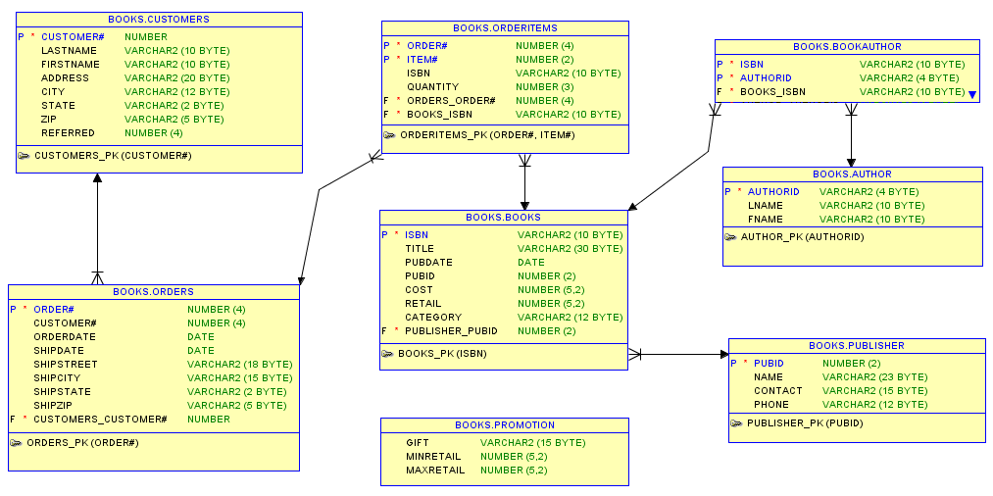
Tables created inside schema to hold data
Book Store
Cruises
Database

Slide 19
Structured Query Language (SQL)
Pronounced see-kwal or ess-kew-ell
“Talk” to a database (SQL statements)
Ask questions
How much money did we make last month
Add new data
Add a new customer
Modify existing data
Change a customer’s address
4th Generation language
Notes:
What's SQL ?
In 1971, IBM researchers created a simple non-procedural language called Structured English Query Language. or SEQUEL. This was based on Dr. Edgar F. (Ted) Codd's design of a relational model for data storage where he described a universal programming language for accessing databases.
In the late 80's ANSI and ISO (these are two organizations dealing with standards for a wide variety of things) came out with a standardized version called Structured Query Language or SQL. SQL is prounced as 'Sequel'. There have been several versions of SQL and the latest one is SQL-99. Though SQL-92 is the current universally adopted standard.
SQL is the language used to query all databases. It's simple to learn and appears to do very little but is the heart of a successful database application. Understanding SQL and using it efficiently is highly imperative in designing an efficient database application. The better your understanding of SQL the more versatile you'll be in getting information out of databases.

Slide 20
SQL
ANSI compliant
Used as front end to many databases
Oracle
IBM DB2
mySQL
PostgreSQL
Microsoft SQL Server
Sybase
Informix
Derby
95-98% of what you will learn can be used in any database

Slide 21
Normalization
Determines required tables and columns for each table
Multi-step process
Used to reduce or control data redundancy
Notes:
What's Database Normalization ?
Normalization is the process where a database is designed in a way that removes redundancies, and increases the clarity in organizing data in a database.
In easy English, it means take similar stuff out of a collection of data and place them into tables. Keep doing this for each new table recursively and you'll have a Normalized database. From this resultant database you should be able to recreate the data into it's original state if there is a need to do so.
The important thing here is to know when to Normalize and when to be practical. That will come with experience. For now, read on...
Normalization of a database helps in modifying the design at later times and helps in being prepared if a change is required in the database design. Normalization raises the efficiency of the datatabase in terms of management, data storage and scalability.
Now Normalization of a Database is achieved by following a set of rules called 'forms' in creating the database.

Slide 22
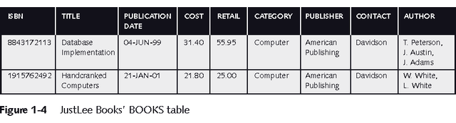
Unnormalized Data
Contains repeating groups in the Author column in the BOOKS table

Slide 23
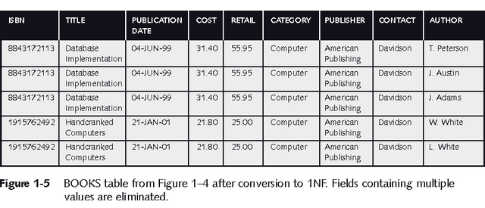
First-Normal Form (1NF)
Primary key is identified
Repeating groups are eliminated
ISBN and Author columns together create a composite primary key
Notes:
Composite Primary Key:
More than one column is required to uniquely identify a row
Can lead to partial dependency - a column is only dependent on a portion of the primary key

Slide 24
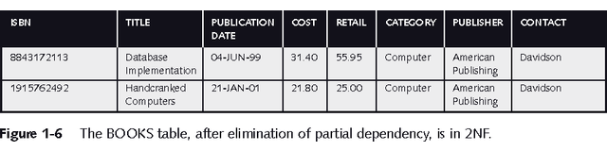
Second-Normal Form (2NF)
Partial dependency must be eliminated
Break the composite primary key into two parts, each part representing a separate table
BOOKS table in 2NF

Slide 25
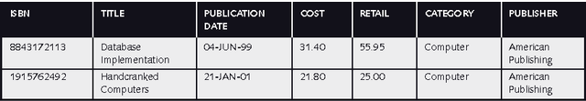
Third-Normal Form (3NF)
Extraneous data removed
Publisher contact name has been removed

Slide 26
Linking Tables
Once tables are normalized, make certain tables are linked
Tables are linked through a common field
A common field is usually a primary key in one table and a foreign key in the other table

Slide 27
End result of 3NF normalization

Slide 28
Oracle 11g SQL Certification Class Session 3 Chapter 2
Using DDL to Create and Manage Tables

Slide 29
Session 3 objectives
Definitions:
Namespace, datatype, constraint
Database Objects
CREATE table syntax
Naming Rules
Schemas and Namespaces
Datatypes
Constraints

Slide 30
Database Objects
Schema objects
Table – Stores data
Index – used to speed up searches
View – creates a filter for looking at data
Sequence – a counter used to generate unique numbers
Private Synonym – an alias for another object in the schema
Constraint – a rule for filtering incoming data
Non Schema Objects
User – the owner of a database object
Role – set of privileges that can be granted to a user
Public Synonym – an alias used for any object by all schemas

Slide 31
CREATE table
Creates a table database object with no data in it
Syntax:
CREATE TABLE table_name (
[column_name datatype,]
column_name datatype
);
Must have at least one column
Comments are optional in any statement, treated as whitespace by SQL engine
Notes:
Items in yellow are optional

Slide 32
Naming Rules
1-30 characters
First character must be a letter
Can include letters, numbers, $,#,_
Cannot be a SQL keyword
Case insensitivity
Use of double quotes

Slide 33
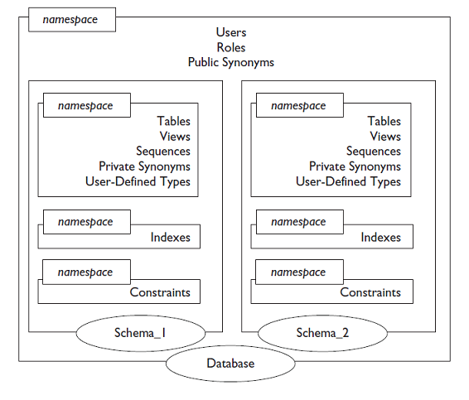
Namespace
Page 56
System namespace
Schema namespace
Index namespace
Constraint namespace
System generated name

Slide 34
Character Datatypes
CHAR(n)
Fixed length text field of length n
n is optional, defaults to 1
Pads with spaces
Maximum length of 2000 characters
VARCHAR2(n)
Variable characters with maximum length n
n is required
No padding
Maximum of 4000 bytes
VARCHAR(n)
Similar to VARCHAR2 but reserved for future use

Slide 35
Numeric Datatypes
NUMBER(n,m)
n is precision: the number of significant digits on either side of the decimal
m is scale:
INTEGER
FLOAT

Slide 36
Date Datatypes
DATE
TIMESTAMP
TIMESTAMP WITH TIME ZONE
TIMESTAMP WITH LOCAL TIME ZONE
INTERVAL YEAR TO DAY
INTERVAL DAY TO SECOND

Slide 37
Other Datatypes
BLOB
CLOB
NCLOB
User defined

Slide 38
Constraints
Constraints are logic used to instruct a table how to accept, modify or reject data
Applies to a field in a table
Composite constraints apply to multiple fields
Four things to explore
In-line vs out-of-line constraint creation (special rules for NOT NULL)
Naming vs not naming of constraints
During vs after table creation
Combining constraints

Slide 39
Constraint types
PRIMARY KEY – used to relate tables, must be unique and NOT NULL, can be composite, can only be one per table
FOREIGN KEY – used to link to PRIMARY KEYs in related tables
UNIQUE – cannot have duplicate values in a table, can be composite
NOT NULL – field must have data in it
CHECK – applies an expression when adding or modifying data
DEFAULT – inserts a default value if left empty. Not really a constraint, but operates like one

Slide 40
CREATE table revised
Creates a table database object with no data in it
Syntax:
CREATE TABLE table_name (
[column_name datatype [in-line-constraint],
… ,]
column_name datatype [in-line-constraint,]
[out-of-line-constraint]
);
Comments are optional in any statement, treated as whitespace by SQL engine
Notes:
Items in yellow are optional

Slide 41
Oracle 11g SQL Certification Class Session 4 Chapter 3
Manipulating Data

Slide 42
Session 4 objectives
Definitions:
DDL, DML. TCL
Types of SQL statements
INSERT statement
UPDATE statement
DELETE statement
Control statements

Slide 43
Three Types of SQL Statements
Data Definition Language
Manage database objects
Issue privileges
Data Manipulation Language
Work with data
Transaction Control Language
Restore data to an earlier state
Committing data
Notes:
Users interact with database systems through query languages. The query language of a DBMS has two
broad tasks:
to define the data structures that serve as receptacles for the data of the database,
and to allow the speedy retrieval and modification of data.
Accordingly, we distinguish between two components of a query language:
the data definition component
the data manipulation component
The main tasks of data manipulation are data retrieval and data update
.
Data retrieval entails obtaining data stored in the database that satisfies a
certain specification formulated by the user in a query.
Data updates include data modification, deletion and insertion.
A central task of DBMSs is transaction management. A transaction is a
sequence of database operations (that usually consists of updates, with possible
retrievals) that must be executed in its entirety or not at all. This property of
transactions is known as atomicity.

Slide 44
DDL Statements
CREATE – creates a database object
DROP – gets rid of a database object
ALTER – changes a database object
RENAME – changes the name of an existing object
TRUNCATE – removes all the rows in a table
GRANT – issues privileges to users and roles
REVOKE – remove privileges from users or roles
PURGE – removes deleted objects from the recyclebin
COMMENT – adds a comment to the data dictionary
FLASHBACK – restores an earlier version of a table

Slide 45
DML Statements
SELECT – retrieves data from a table or view
INSERT – adds new data to a table
UPDATE – modifies data in a table
DELETE – removes existing data from a table
MERGE – performs a combination of INSERT, UPDATE and DELETE

Slide 46
INSERT Statement Syntax
INSERT INTO table_name [(column list)]
VALUES (expression list);
If the column list is omitted, the columns must be as defined in DESC table_name. This is the default column list.
The table, column names are validated against the table
Datatypes are validated against the table columns although Oracle can do some automatic data conversion
Data is validated against the columns’ constraints
Notes:
Items in yellow are optional

Slide 47
UPDATE Statement Syntax
UPDATE tableName
SET [column = data,
…,]
column = data
[WHERE clause];
The column = data list is delimited by commas
Columns do not need to be in any particular order
If WHERE is omitted, UPDATE modifies all the rows in a table
Data is validated against constraints
Notes:
Items in yellow are optional

Slide 48
DELETE Statement Syntax
DELETE FROM table_name
[WHERE clause];
FROM is optional
If WHERE is omitted, DELETE removes all the rows in a table
Because its difficult to determine what is lost, its advisable to do a SELECT statement with the WHERE clause first.
Notes:
Items in yellow are optional

Slide 49
TCL Statements
A transaction is a series of DML statements. The changes made during a transaction are only visible to the user making the changes until it is committed to the database
Any DDL statement automatically commits a transaction
COMMIT – Saves the data to the database
ROLLBACK – restores uncommitted data to an earlier state
SAVEPOINT – marks a point in a transaction to which rollbacks can be issued

Slide 50
Oracle 11g SQL Certification Class Session 5 Chapter 4
Retrieving Data Using the SQL SELECT Statement

Slide 51
Session 5 objectives
Definitions:
Distinct, Unique,
SELECT statement
Pseudocolumns
DISTINCT or UNIQUE
Expressions

Slide 52
SELECT Statement Syntax
SELECT column list or *
FROM table_name
[WHERE clause]
[ORDER BY clause];
SELECT clause identifies which columns to return (projection)
Use * to select all the columns
Can’t have both a column list and a *
FROM clause specifies the tables to use
WHERE clause limits the number of rows (selection)
ORDER BY sorts the output (result set)
Notes:
Items in yellow are optional

Slide 53
Pseudocolumns
Values defined automatically by the Oracle system
ROWNUM – system assigned number for a row (assigned before ORDER BY clause is processed
ROWID – system assigned physical address for a row.
CURVAL – sequence pseudocolumn to return current value
NEXTVAL – sequence pseudocolumn to return the next number in the sequence and increment the sequence

Slide 54
Expressions
Expressions can be used wherever a single value can be used
Literals – a number or a string in single quotes that is a value
Operators – (), *,/,+,- follows math precedence rules
Functions – a named subroutine that takes incoming values and returns a result

Slide 55
Oracle 11g SQL Certification Class Session 6 Chapter 5
Restricting and Sorting Data

Slide 56
Session 6 objectives
Definitions:
ORDER BY,
WHERE clause
Comparisons
Boolean Logic
Sorting output
Column alias

Slide 57
WHERE clause
Limits the rows in the output
Always follows the FROM clause
Uses expressions to decide how to limit the output
Comparison operators: =, >=, <=, >, <, !=, <>,^=
Can use numbers, strings and dates

Slide 58
Boolean Logic
X | Y | AND
T | T | T
T | F | F
F | T | F
F | F | F
X | NOT X
T | F
F | T
NOT is evaluated first
AND is evaluated next
OR is evaluated last
Parenthesis can be used to force precedence
X | Y | OR
T | T | T
T | F | T
F | T | T
F | F | F

Slide 59
WHERE clause features
IN – compares value on let to a set of values in parenthesis
IS – used with NULL and NOT NULL
LIKE - Enables simple wildcard searches
Underscore _ represents a single character
Percent % represents zero or more characters
Between – compares a single value to a range of values

Slide 60
ORDER BY clause
Can use column names
Can use output column numbers (reference by position)
Can use expressions
Can use aliases defined in the SELECT clause
ASC – ascending lowest to highest (the default)
DESC – descending highest to lowest
NULL is higher than other values

Slide 61
Column Aliases
Each expression in the SELECT clause may optionally be followed by a column alias
AS is an optional keyword in creating a column alias
An alias in “” can uses spaces and other special characters
Aliases not in “” follow identifier naming rules
Column aliases do not exist outside the SELECT statement
Column aliases become the new headers in the result set
Column aliases can only be used in ORDER BY clause and nowhere else

Slide 62
Oracle 11g SQL Certification Class Session 7 Chapter 6
Using Single-Row Functions to Customize Output

Slide 63
Session 7 objectives
Definitions:
Parameter, Nesting
Text functions (String or Character functions)
Number functions
Date functions
Other Functions

Slide 64
Text Functions
Concatenation operator is two vertical bars: ||
Concatenates (combines) the two strings on either side
Usually called a double pipe
CONCAT(s1, s2) – concatenates s1 and s2 into a single string
UPPER(s1) – converts text in s1 to upper case
LOWER(s1) – converts text in s1 to lower case
INITCAP(s1) – converts text in s1 to capitalize first letter in each word, all other characters lower case

Slide 65
Text Functions
LPAD(s1, n [, s2]) – pads string s1 to the left up to n characters with s2
s2 is optional, default if omitted is a space
RPAD(s1, n [, s2]) – pads string s1 to the right up to n characters with s2
s2 is optional, default if omitted is a space
LTRIM(s1[, s2]) – removes s2 from the left end of s1
RTRIM(s1[, s2]) – removes s2 from the right end of s1
S2 if omitted defaults to a space
TRIM([trim_info] [trim_char FROM] s1) – removes trim_char from s1
trim_info is LEADING, TRAILING or BOTH. If omitted default is BOTH
trim_char FROM if omitted is a space

Slide 66
Text Functions
LENGTH(s1) – returns the number of characters in s1
INSTR(s1, s2 [,pos [,n]]) – returns the location of s2 within s1
Pos is the starting position within s1 to start looking for s2
If omitted, pos defaults to 1
If negative, pos starts from the end of the string
n is the occurrence of s2 to look for, defaults to 1 if omitted
To use n, you must use pos
SUBSTR(s1, pos[, len]) – returns a character string of length len starting at position pos.
If len is omitted, retuns all characters from pos to the end of s1

Slide 67
Text Functions - SOUNDEX
SOUNDEX(s1) – translates s1 into a SOUNDEX code
Soundex code is a letter followed by 3 digits
double letters are ignored, as are vowels and H, W, Y
pads with 0
Letter | SOUNDEX Code
B,F,P,V | 1
C,G,J,K,Q,S,X,Z | 2
D,T | 3
L | 4
M,N | 5
R | 6
All other letters | Ignored

Slide 68
Number Functions
ROUND (n[, pos]) – Rounds n to pos places
TRUNC (n[, pos]) – Truncates to pos places
REMAINDER (n1, n2) – Identifies the multiple of n2 nearest to n1 and returns the difference
MOD (n1, n2) – Identifies the multiple of n2 less than n1 and returns the difference
FLOOR
CEIL
ABS
LEAST
GREATEST

Slide 69
Date Functions
SYSDATE – returns the current date and time in DATE datatype of the database server
ROUND(date[, format]) – rounds the date to the level of detail specified by the format (‘HH’ is default if omitted)
TRUNC(date[, format]) – rounds the date down to the level of detail specified by the format (‘HH’ is default if omitted)
NEXT_DAY(date, dow) – Returns the next day of the week specified by the text string dow after the date.
LAST_DAY

Slide 70
Date Functions
NEXT_DAY
LAST_DAY
ADD_MONTHS
MONTHS_BETWEEN
NUMTOYMINTERVAL
NUMTODSINTERVAL

Slide 71
Other Functions
NVL
NVL2
DECODE
CASE
NULLIF

Slide 72
Oracle 11g SQL Certification Class Session 8 Chapter 6
Using Single-Row Functions to Customize Output

Slide 73
Session 8 objectives
Definitions:
To_number, to_char, to_date
Conversion Functions
Automatic Datatype Conversions
Time Zones
Time Zone Conversion Functions

